Slide 1
Graphical Excellence
Part II

Slide 2
Tufte’s Design Principles
Above all else, show the data:
Maximize data-ink ratio
Erase non-data ink
Erase redundant data ink
Revise and edit

Slide 3
What is the Data-Ink Ratio?
• Data-ink = the ink used to show data
• Data-ink ratio = data-ink / total ink used
(This is an idea – we will not calculate this)

Slide 4
Some Strategies for Increasing Data-Ink Ratio
Avoid Chartjunk
Small Multiples
Sparklines
Simplify! (Erase non-data and redundant ink)

Slide 5
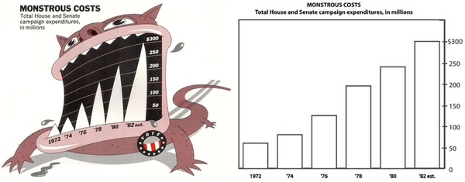
1. Avoid Chartjunk*
*(But there are different opinions on this….)
https://eagereyes.org/blog/2011/want-to-make-chart-memorable-add-junk

Slide 6
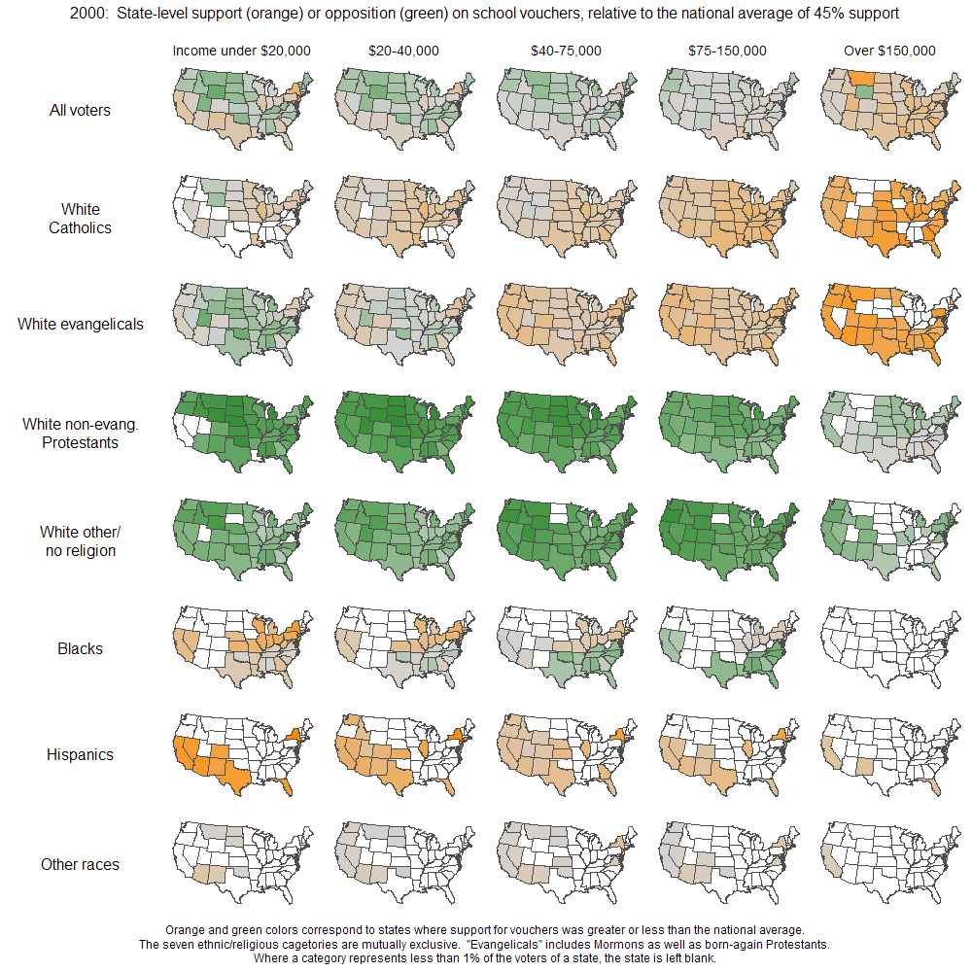
2. Small Multiples
Andrew Gelman’s analysis of public support for vouchers, broken down by religion/ethnicity, income, and state.

Slide 7
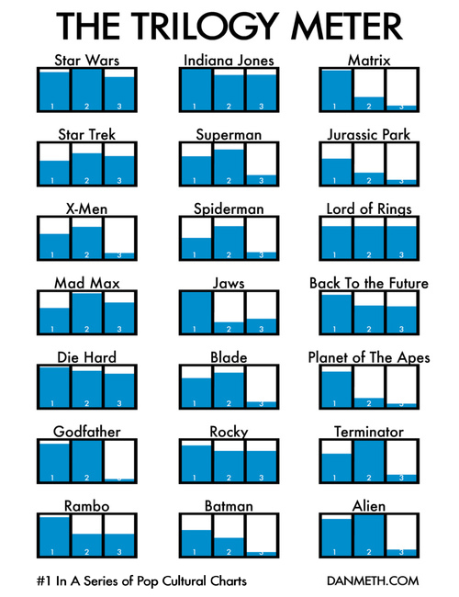
2. Small Multiples
Trilogy Meter by Dan Meth shows movie enjoyment by sequel.

Slide 8
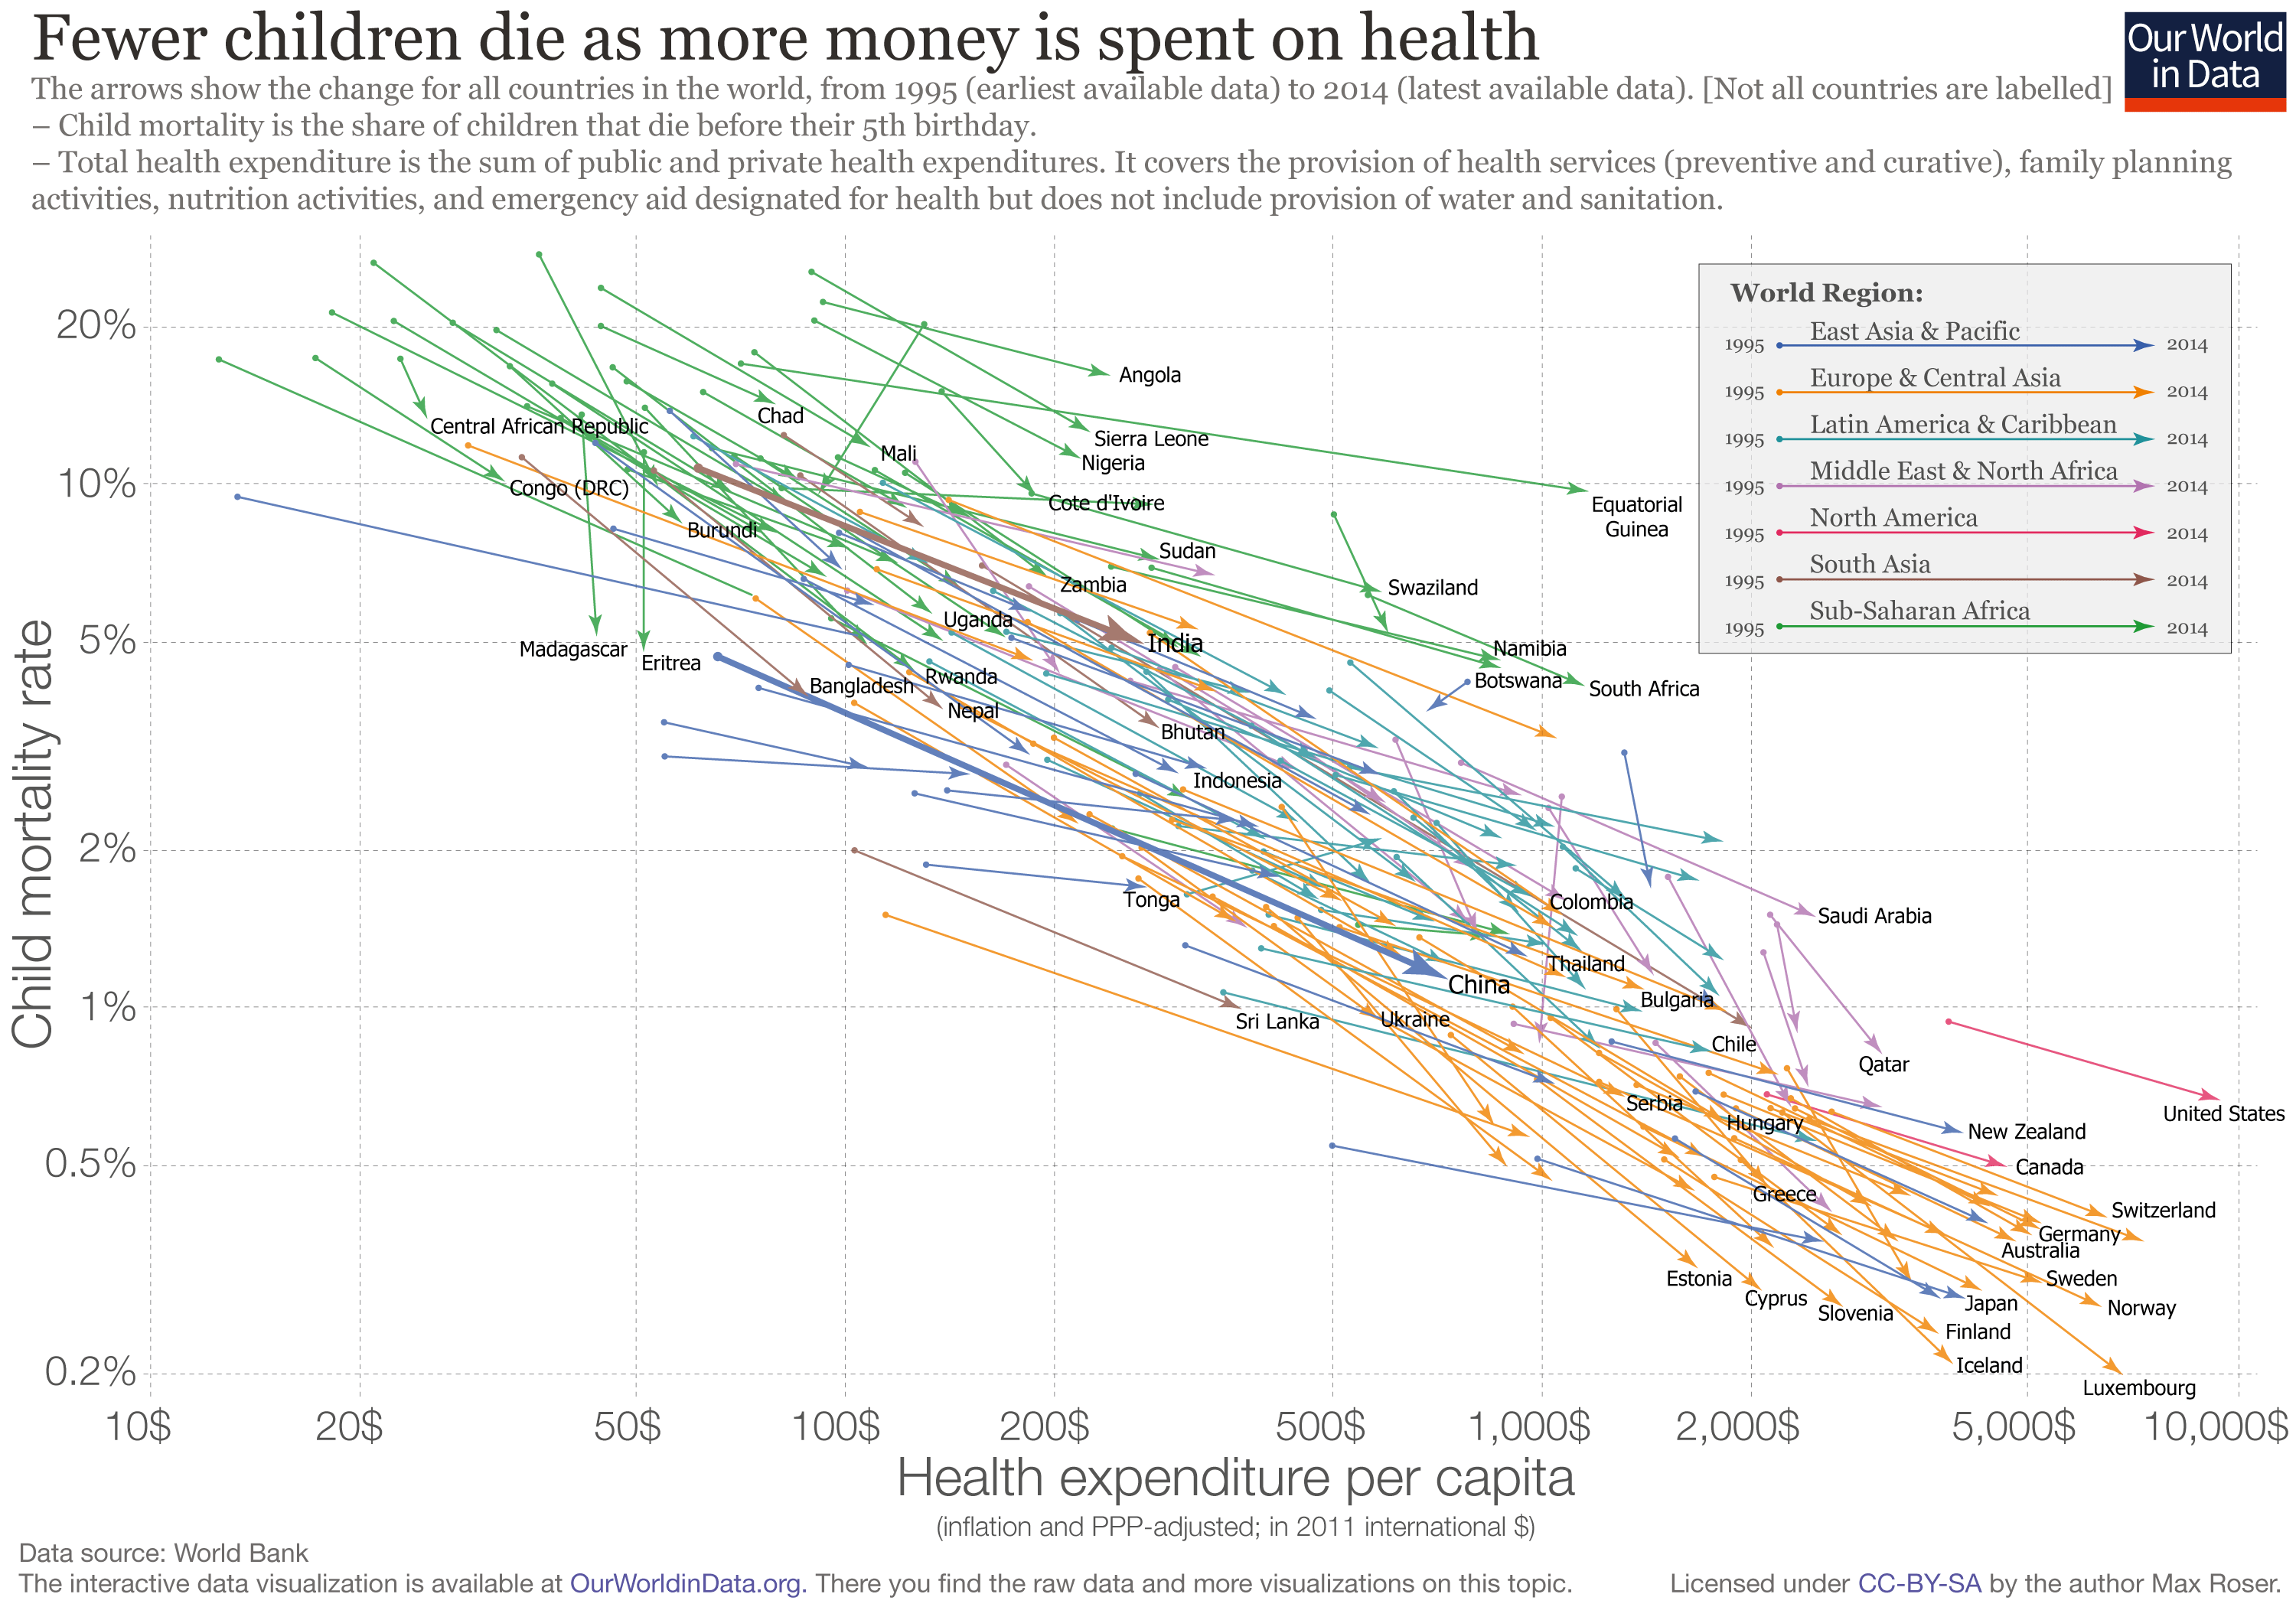
2. Small Multiples ( htttps://flowingdata.com/2017/05/09/life-expectancy-by-state-against-the-us-average/)

Slide 9
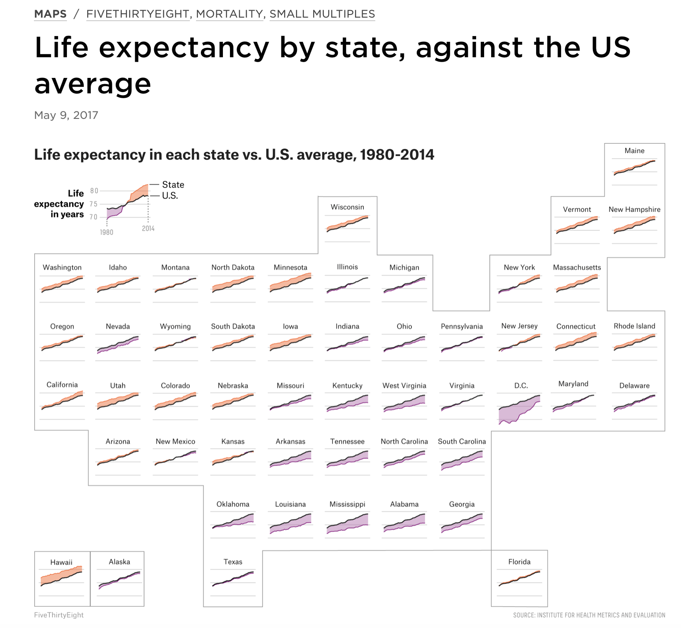
3. Sparklines
(Really, a kind of Small Multiples)
http://www.juiceanalytics.com/writing/better-know-visualization-small-multiples.

Slide 10
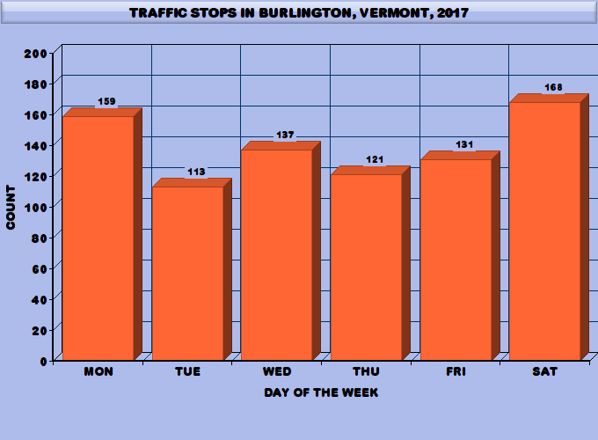
4. Simplify.
Start with this chart,
(I used https://www.
onlinecharttool.com )

Slide 11
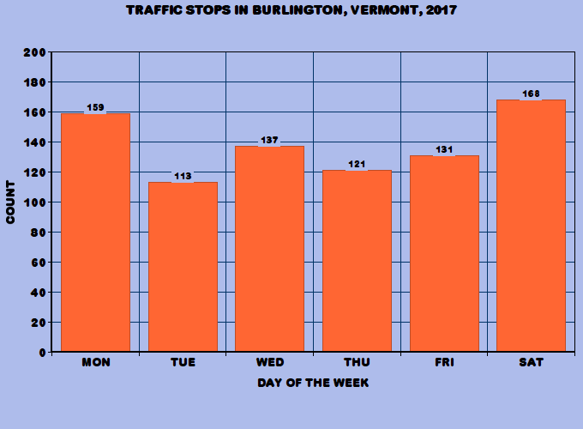
4. Simplify.
3D is the worst!

Slide 12
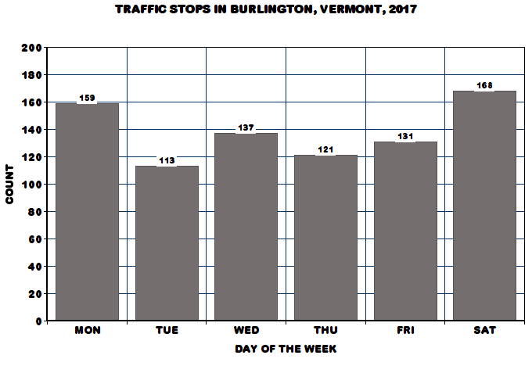
4. Simplify.
Color can be distracting…

Slide 13
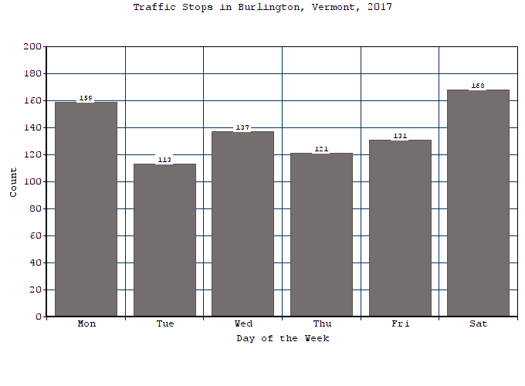
4. Simplify.
Use a classic font.

Slide 14
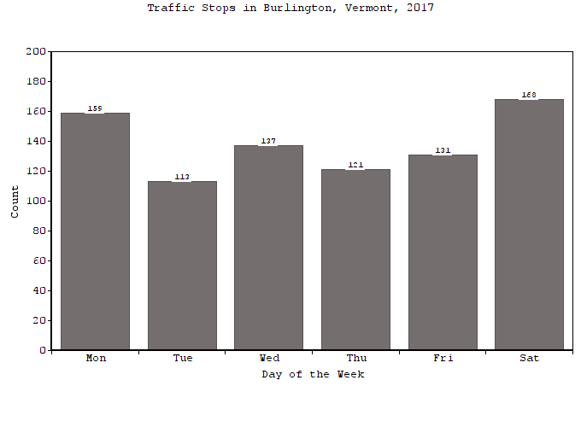
4. Simplify.
Grids can be
Distracting.

Slide 15

4. Simplify.
Numbers on
bars are
unnecessary

Slide 16
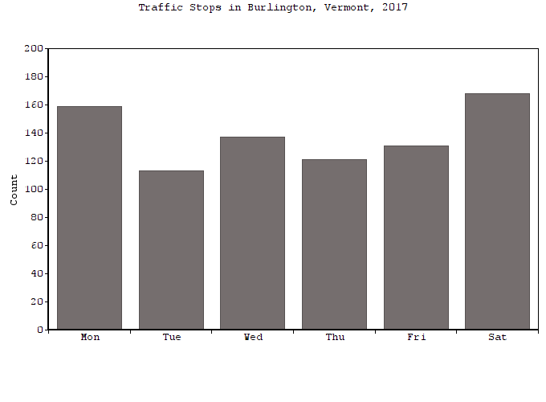
4. Simplify.
“Day of the Week” label is not necessary either.

Slide 17
4. Simplify.
Now try using ggplot2. Here is a basic plot

Slide 18
4. Simplify.
Basic ggplot with color.

Slide 19
4. Simplify.
Without ‘Weekday’ label.

Slide 20
4. Simplify.
Using themes:
theme_bw()

Slide 21
4. Simplify.
Using themes:
theme_light()

Slide 22
4. Simplify.
Using themes:
theme_minimal()

Slide 23
4. Simplify.
Using themes:
theme_void() ???

Slide 24
The best graphs are:
Data Dense
Uncluttered
Not Redundant
Not Misleading (e.g., correct for inflation)
Tell a Story..
Here’s a famous example:

